Slide 1
5.2: Graphs of Sine and Cosine Functions
MATH 1550 - Precalculus

Slide 2
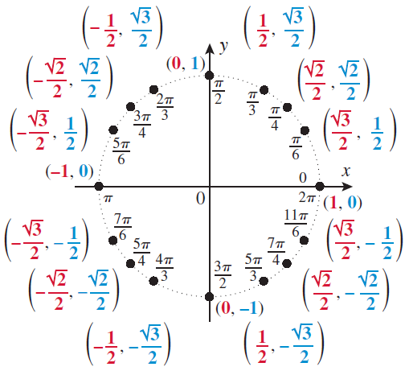

Slide 3
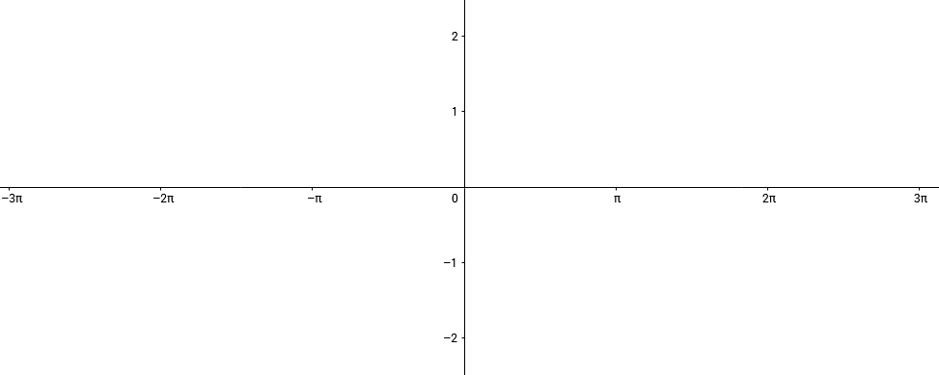

Ex: Plot $y=\sin{x}$,$y=\frac{1}{2}sin⁡x$,$y=2\sin{x}$.

Slide 4
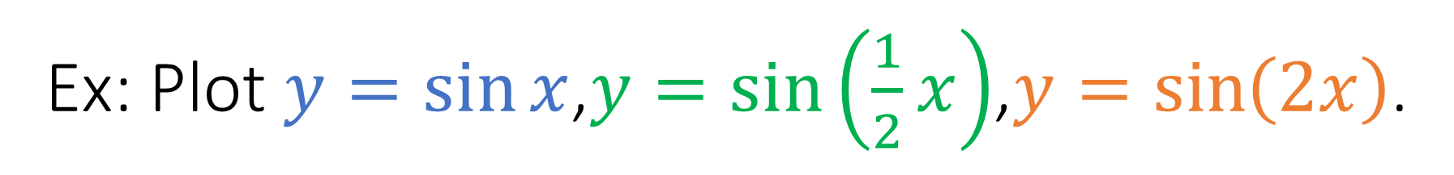
Ex: Plot $y=\sin{x}$,$y=sin\left(\frac{1}{2}{x}\right)$,$y=\sin\left(2x\right)$.
Notice the fundamental period changes also.

Slide 5


Ex: Plot $y=3sin\left(\frac{π}{3}x\right)$.
First, a horizontal compression
Then a vertical stretch

Slide 6

Ex: Plot $y=2cos\left(2x−π\right)−1$.
First, a horizontal compression
Then a phase shift
Then a vertical stretch
Lastly, a vertical shift

